Slide 1
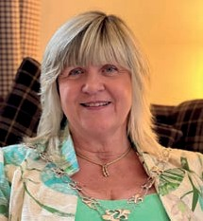
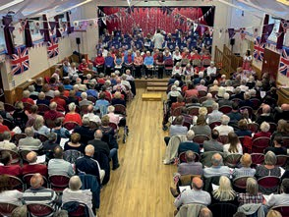
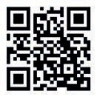
Chairman’s Message
Rustington Parish Council Newsletter Issue No. 76 - Winter 2023
Looking back on 2022, there were some real highs and lows for us all. We seem to have settled into a new normal with the Pandemic, but are now living with the major ‘cost of living’ crisis, which we are all feeling the adverse effects of.
For those parishioners who are finding themselves struggling
to cope with the ever-increasing costs of the essential everyday needs, e.g. electric, gas, other utilities and food, etc., there is help available. We have worked closely with our District and County Councils alongside the Voluntary Sector to ensure residents are aware, and have included in this Newsletter a contact list for local organisations and agencies that can provide assistance.
In the Council world, this will be yet another busy year, which will include your chance to elect representatives for both the Parish Council and the Arun District Council on
4 May. I would urge anyone who is interested in becoming a Councillor to get in touch with the Council Offices or, indeed, the Elections Office at the Arun District Council, to obtain the necessary nomination forms which will be available from 21 March.
As I approach the end of my second year of my second term as Chairman of this truly committed Council, I look back at the Events I have had the pleasure of attending, and the excellent work that so many members of our local community do to ensure that Rustington continues to be the thriving and vivacious Village that it is today. I would like to express my sincere appreciation to everyone for all that they do.
There will, as always, be some exciting Events during the coming year, including a ‘Last Night of the Proms’ Concert (Sunday 7 May - Hosted by the Parish Council, in partnership with the Littlehampton Concert Band) and a Themed Quiz Night (Friday 5 May - Hosted by the Littlehampton District Lions Club) at The Woodlands Centre, to celebrate the Coronation of King Charles III, plus, I am sure, a number of other Events and Activities,
on and around the date of the Coronation, namely 6 May. The always popular Rustington Street Fayre, organised by the Littlehampton District Lions Club, will be taking place in the centre of the Village on a date yet to be confirmed in July. Full details of this Event will appear in the next edition of the Newsletter.
For now, it just leaves me to thank all of you, the Parishioners of Rustington, for your unceasing support of your Parish Council with the services that it provides and strives to improve and extend, for the benefit of the Village.
Councillor Mrs Alison Cooper
The Coronation of His Majesty King Charles III
As everyone will be aware, the Coronation of His Majesty King Charles III will take place on Saturday
6 May (Ceremony at Westminster Abbey, London).
The Parish Council, in partnership with the
Littlehampton Concert Band, will be hosting a Coronation ‘Last Night of the Proms’ Concert on the afternoon of Sunday 7 May, commencing at 2.30 pm. The Concert will be held in the Village Memorial Hall at The Woodlands Centre and entry will be free by ticket only. Tickets will be available on a first come first serve basis from the
Information Centre (Samuel Wickens Centre) from 1 April.
For further information, please contact the Parish Council Offices on 01903 786420 or email: enquiry@rustingtonpc.org
Look out for details of any other ‘Coronation’ Events being organised by local Groups, Clubs and Organisations on the Council’s Facebook Page.
34 Woodlands Avenue, Rustington, West Sussex BN16 3HB Offices Open Monday - Friday 10.00 am to 4.30 pm
Tel: 01903 786420 Emergency Mobile: 07752 493539
Fax: 01903 788736 Email: enquiry@rustingtonpc.org
@rustingtonpc
www.rustingtonpc.org

Slide 2
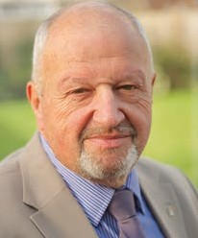
Rustington Parish Council Newsletter Issue No. 76 - Winter 2023
2023/2024 Parish Council Tax
Every year the Parish Council spends money on various local services that it provides for the benefit of the local community. This expenditure forms a small part of the Council Tax that Parishioners pay to the Arun District Council. The
money raised is called the Precept. At this time of year, the Council has to consider the level at which to set this Precept and has recently decided that it must increase its 2023/2024 Precept to £759,000.00.
This decision will result in an annual Parish Council charge on a Band ‘D’ property in Rustington of approximately £124.00, an increase of just over £11.00 on the previous year, equating to under £1.00 per month.
Your Parish Council is proud of its achievements and continues to offer its Parishioners excellent value for money with the wide range of services it provides, whilst always remaining mindful of the burden its expenditure might place on them.
In closing this message, can I remind you that Parishioners will have the opportunity to find out more about how the Council has spent its Precept during the past year, and how it plans to spend it during the next financial year at the Annual Assembly of the Parish Meeting, scheduled to be held on Thursday 13 April in the Village Memorial Hall at The Woodlands Centre commencing at 7.30 pm. Parishioners are also welcome to make arrangements, via
the Council Offices, to meet with me to discuss any questions they might have on the Council’s financial operation.
Councillor Graham Tyler - Chairman
Finance and General Purposes Committee
COST OF LIVING SUPPORT
LOCAL HELP IS AVAILABLE
West Sussex Community Hub
Help and Support is available for eligible residents who are struggling with fuel and food costs. Open 7 days a week. Helpline Tel: 033 022 27980 www.westsussex.gov.uk
Drop in for a Warm Welcome and Free:
Rustington Library
OPENING TIMES
Information and advice Internet access and help to get you online Events and activities Access to direct support from a range of partners, for example health and wellbeing, or financial advice.
Monday: 10.00am - 5.00pm
Tuesday: 10.00am - 5.00pm
Wednesday: 10.00am - 5.00pm
Thursday: 10.00am - 5.00pm
Friday: 10.00am - 5.00pm
Saturday: 10.00am - 2.00pm
The Littlehampton Foodbank
It doesn't matter if you work and it doesn't matter where you work - help is available to support anyone who is facing a financial crisis and has little or no money for the basics.
Tel: 0808 208 2138 to access a voucher for a 3 day supply of non-perishable store cupboard items and toiletries.
Community Fridge on Tour
Open to everyone and FREE of charge with no referral required. All food is rescued and simply needs a home to stop it being wasted.
Rustington Methodist Church, Claigmar Road Wednesdays 2.00pm - 3.00pm
Saturdays 11.00am - 12.00pm
CAP Debt Help - Christians Against Poverty
If you are struggling with debt and need some help call
Freephone 0800 328 0006.
CAP is a free debt counselling and advice service that offers a listening non-judgemental ear and a real solution to your debts.
St Peter and St Paul's Pantry
A space where anyone in the community who is struggling can top up their weekly food supplies - no referrals or registration required.
1st Wednesday of the month: 4.00pm - 6.00pm
2nd Wednesday: 8.30am - 10.00am 3rd Wednesday: 4.00pm - 6.00pm
4th/5th Wednesday: 10.00am - 12.00pm
Rustington Church Hall, 77 The Street
Further available support through Citizens Advice
Hardship Helpline: 0808 208 2138
General Advice: 0808 278 7969
2

Slide 3
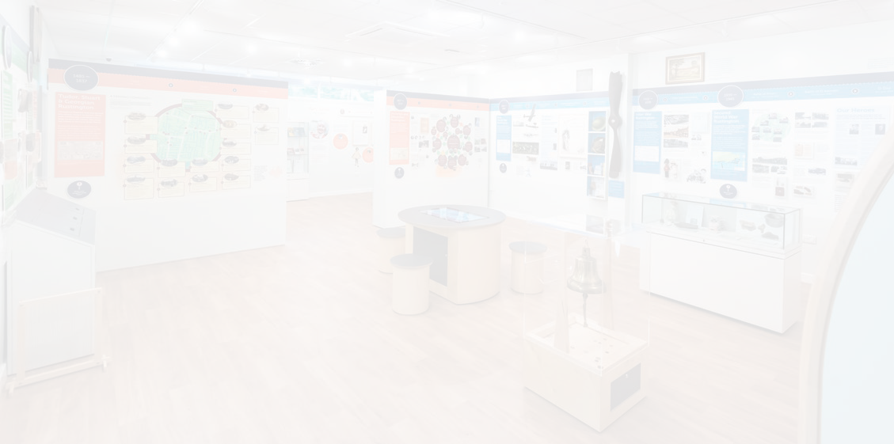
Rustington Museum
Rustington Parish Council Newsletter Issue No. 76 - Winter 2023
2023 in the Museum includes lots to look forward to. Its busy programme incorporates Exhibitions, Talks, and Family Crafty Events.
One piece of great news to start the year with was confirmation that Rustington Museum has retained its Accredited
Museum status! It shows that we meet the nationally agreed standards for Collection Care, Documentation and Engagement.
By the time you read this article, a new ‘Rustington Churches’ Exhibition will be on display. With
items and photos, it explores their histories in the Village. The Community Cases are being used to showcase Collections from the public, but also to commemorate events nationally and in the Village. If you have a Collection that you would like to ‘show off’ or know a Community Group that would love to display its work, get in contact with the Museum (details below).
In the Summer, there will be an Exhibition all about the history of the RAF Benevolent Fund’s Princess Marina House site and the Blind Veterans UK Charity, who have acquired the building and are currently in the throes of a major refurbishment programme, prior to relocating from its current Centre, the former St Dunstan’s in Ovingdean.
We are looking to make this a Community Exhibition, so if you worked at either site, had family who lived there or any other connections,
Rustington Youth Club
Rustington Youth Club, located at the Woodlands Recreation Ground, opens its doors each Thursday evening between 7.00 pm - 9.00 pm for young people aged
11-18 years.
We are excited to enter Spring and already have some Easter activities planned for our sessions, lots of chocolate themed ones!
we would love to hear from you! We are looking for photos, memories or objects that help to tell the stories of these amazing Charities and the sites they occupied.
The Museum’s Talk Series is proving to be very popular, with the topics featuring Rustington and Sussex. They are all free to attend, and tickets can be booked in person at the Museum or
via Eventbrite - visit the Museum website and Facebook page for the latest information.
Wednesday, 22 March at 2.00 pm:
Get the inside scoop on the celebrities that made Littlehampton and the surrounding area their home from Peter Walton in his talk ‘Famous Faces’. You’ll be surprised at just how many there are!
Wednesday, 19 April at 2.00 pm:
Dr Kathryn Ferry will be exploring the heyday of seaside architecture, featuring some well-known sites along our coast.
Wednesday, 24 May at 7.00 pm:
An evening of entertainment from the Southdown Singers with renditions of traditional Sussex folk songs and the history behind them.
The Museum is located in the Samuel Wickens Centre, Broadmark Lane Car Park (behind Waitrose), BN16 2NW Tel: 01903 788478 or Email: museum@rustingtonpc.org www.rustingtonmuseum.org
@Rustington Museum RustingtonMuse1
Open Monday to Saturday 9.00 am - 5.00 pm (Closed 1.00 pm - 1.30 pm).
Claire Lucas - Museum Manager
Each week we serve hot food and drinks, entry/subs are 50p and there will also be tuck available each week (cash only).
If you want to know any more information about the Club, @ArunYouthProjects Emma.Biffi@arunchurch.com
Matt Pollard, Worker in Charge
- Arun Youth Projects
follow us or email -
3

Slide 4
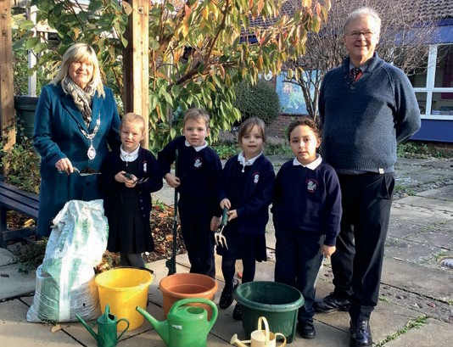
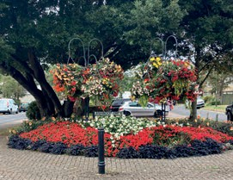
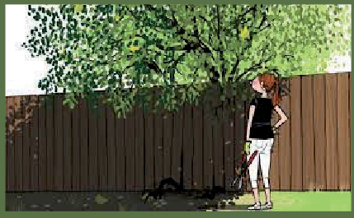
Village Gardens Competition
Rustington Parish Council Newsletter Issue No. 76 - Winter 2023
Now is the time to start thinking about this year’s Gardens Competition which is divided into the following classes:
Class 1 - Window Boxes, Balconies and Patio Tubs etc. (Residential)*
Class 2 - Window Boxes, Balconies and Patio Tubs etc. (Commercial)*
Class 3 - Front Gardens of Any Size, including Paved Gardens with Patio Tubs (Residential)*
Class 4 - Front Gardens of Any Size (Commercial)*
Class 5 - Schools’ Competition
Class 6 - Community Gardens
*Entries must be clearly visible from the Road
Parishioners and local businesses are encouraged to start thinking about their planting plans now so that they can nominate either themselves, their neighbours, or any members of the local Community for the Competition. Further details will appear in the next issue of this Newsletter.
Schools’ Bulb Planting
Every year the Parish Council purchases a quantity of bulbs, as part of its continuing planting scheme, and last year was no exception, when all three Primary Schools in Rustington accepted the Council’s offer of
a quantity of bulbs to plant in the Schools’ grounds.
In November the Chairman, Councillor
Mrs Alison Cooper, joined pupils at Georgian Gardens Community Primary School to assist with the Bulb Planting. She was most
impressed by the enthusiasm and commitment demonstrated by the pupils.
Georgian Gardens CP School pupils and Mr L Pettitt
Sponsorship of Planters
Whilst a number of floral displays in the Village are sponsored, the Council continues to look for local businesses,
organisations and individuals who would be willing to sponsor the cost of planting and maintaining a number of other individual displays.
If you feel that you might be interested in such a sponsorship, please contact the Council Offices for further information in this regard - Tel: 01903 786420.
If you have an overhanging bush or tree We hope that you respect this little plea....
Please give it a good trim and a chop So on nobody's head it does bop!
If you have vegetation that overhangs the public highway, please be considerate of pedestrians, especially those with disabilities or using pushchairs, by cutting it back to help ensure footpaths are fully accessible for all.
4

Slide 5
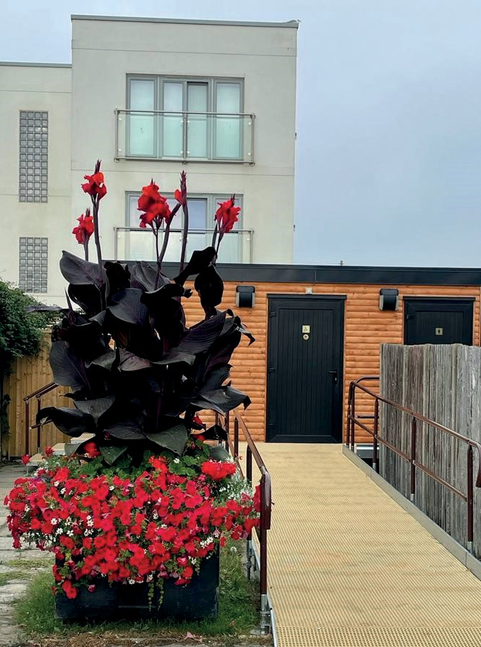
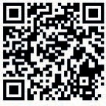
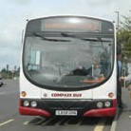
Loo of the Year Awards
Rustington Parish Council Newsletter Issue No. 76 - Winter 2023
The Parish Council continues to win impressive Awards for its Public Toilets
The Parish Council is, once again, delighted to have won one Platinum and two Gold Loo of the Year Awards in the 2022 search to find the best ‘away from home’ toilets in the UK. The Rustington entries were in the Public Toilets (Non-Attended) Category.
The Loo of the Year Awards and associated Washroom/ Toilet Cleaner of the Year Awards for cleaning staff have been identifying the best toilets/washrooms in Britain since 1987 and are recognised as standard setters for all those who provide ‘away from home’ facilities for staff, customers and visitors.
Every entry received an unannounced visit from a Loo of the Year Awards Inspector and was assessed against 101 judging criteria - including signage and décor, fixtures and fittings and overall standards of cleanliness and management. Every washroom receives a grading ranging from Bronze to Diamond and Gold, Platinum and Diamond winners are short listed for one or more of several National Awards covering England, Scotland, Wales, Northern Ireland and the Irish Republic.
Parishioners’ Award
As in previous years, the Council is, once again, inviting all members of the community to submit nominations for the 2023 Parishioners’ Awards.
Two awards can be made each year - one to an Individual and one to a Group/ Organisation - in recognition of outstanding Public Service to the Community. All Rustington parishioners or parish-based
organisations (including voluntary groups and professionals) are eligible to receive these Awards.
Individuals, Groups and Organisations from outside of the Parish, who make an outstanding contribution for the benefit of the community of Rustington, may also be
considered for these Awards. These are ‘once in a lifetime’ Awards and will not be presented on more than one occasion to any Individuals, Groups, Clubs, Organisations or Associations.
Nomination Forms can be downloaded from the Council’s Website: www.rustingtonpc.org
Alternatively, to request a Nomination Form, please telephone the Council Offices (01903 786420) or email: enquiry@rustingtonpc.org
The closing date for the
receipt of nominations is Monday 24 April and the winners will be announced in June.
NUMBER 12 BUS
Monday to Friday Littlehampton Tesco to Rustington Sainsbury's return 5 times a day
Visit www.compass-travel.co.uk for full timetable details
Provided with the support of:
5

Slide 6
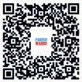
Rustington Parish Council Newsletter Issue No. 76 - Winter 2023
Grant Aid to
Local Groups and Organisations 2023/2024
The Council has funds available to assist local Groups and Organisations.
Applications must be received in the Council Offices by no later than 1 June 2023.
A copy of the Guidance Notes for Potential Applicants can be downloaded from www.rustingtonpc.org
or Email: enquiry@rustingtonpc.org
or from the Council Offices in Woodlands Avenue.
Annual Assembly of the Parish Meeting
This is a Meeting of the Parish and is, therefore, open to all electors. It gives everyone an opportunity to discuss local matters, and ‘meet’ their Parish, District and County Councillors. It is held in the Village Memorial Hall, The Woodlands Centre, Woodlands Avenue.
This year's Meeting is scheduled to be held on Thursday 13 April commencing at 7.30 pm. The Guest Speaker will be Ms Lesley Garven, Centre Manager of Blind Veterans UK, who will provide the Meeting with a little background information on the Charity, its refurbishment and reconfiguration of the former Princess Marina House, out-
buildings and grounds, and its plans for the future, including its integration with the local community of Rustington, in particular.
Complimentary light refreshments will be available at the conclusion of the Meeting.
Meetings
Parish Council Meetings are held on the fourth Monday of each month (apart from August and December) commencing at
7.00 pm (Public Question Time) at The Woodlands Centre, Woodlands
Avenue, via the Council Offices’ entrance.
Thursday 13 April 7.30 pm
Your Parish Council
Meeting Dates
Chairman
Mrs A B Cooper (East Ward) alisoncooper@rustingtonpc.org
Mon 13 Mar Planning
Mon 27 Mar Finance & General
Purposes Mon 27 Mar COUNCIL
Mon 3 Apr Allotments Mon 3 Apr Planning
Thur 13 Apr ANNUAL ASSEMBLY
Mon 24 Apr Finance & General Purposes Mon 24 Apr COUNCIL
Mon 24 Apr Planning
Mon 15 May Finance & General Purposes Mon 15 May ANNUAL COUNCIL
Mon 15 May Planning
Mon 12 Jun Planning
Mon 12 Jun Leisure & Amenities
Mon 26 Jun Finance & General Purposes Mon 26 Jun COUNCIL
Mon 26 Jun Planning
Vice-Chairman G M Tyler (East Ward)
grahamtyler@rustingtonpc.org
East Ward
J E Ceiriog-Hughes johnceiriog-hughes@rustingtonpc.org
Ms M E Revell P D Warren North Ward M E Broomfield M J Clayden West Ward
J F Bennett
mariarevell@rustingtonpc.org peterwarren@rustingtonpc.org
michaelbroomfield@rustingtonpc.org mikeclayden@rustingtonpc.org
jamiebennett@rustingtonpc.org
Mrs C P Broomfield christinebroomfield@rustingtonpc.org
A J Cooper
Mrs P A Gregory R S Grevett
Mrs S A Partridge J W A Street
andycooper@rustingtonpc.org paulinegregory@rustingtonpc.org bobgrevett@rustingtonpc.org peggypartridge@rustingtonpc.org jonstreet@rustingtonpc.org
West Preston Ward
D E Rogers donrogers@rustingtonpc.org
Clerk of the Council
Mrs Carole Ward caroleward@rustingtonpc.org
6

